Slide 1
Detection of Pedestrians in CARLA
Roei Levi

Slide 2

Motivation
Urban environments involve complex pedestrian interactions.
Safety is key for public trust in autonomous vehicles.
Goal: Detect and respond to pedestrians in real time using CARLA to prevent collisions.

Slide 3
Project Requirements - Functional Requirements
Detect pedestrians using sensor data within the simulation.
1
Track detected pedestrians across frames to maintain identity over time.
2
Estimate the motion of each pedestrian (e.g., position, velocity).
3
Predict potential collisions between pedestrians and the ego vehicle.
4
Trigger appropriate vehicle responses (e.g., braking) to avoid collisions.

Slide 4
Project Requirements - Technical Requirements
Integrate an object detection model (e.g., YOLO) for identifying pedestrians in camera frames.
1
Use a multi-object tracking algorithm (e.g., DeepSORT) to track pedestrians over time.
2
Implement a motion estimation model (e.g., Kalman Filter) to estimate pedestrian trajectories using sensor data (e.g. LiDAR).
3
Develop a collision prediction module that evaluates future intersections of paths.
4
Design an agent to control the ego vehicle's response based on predicted collisions.
5
Use CARLA as the simulation environment for development and testing.

Slide 5
Project Requirements - Constraints
The simulation is limited by the capabilities and fidelity of the CARLA simulator.
Real-time performance and model complexity are constrained by available hardware resources.
The entire system must be completed within the project’s deadline.
The project scope focuses only on pedestrians — interactions with other road users are excluded.
The project scopes assumes that all sensors function correctly.

Slide 6
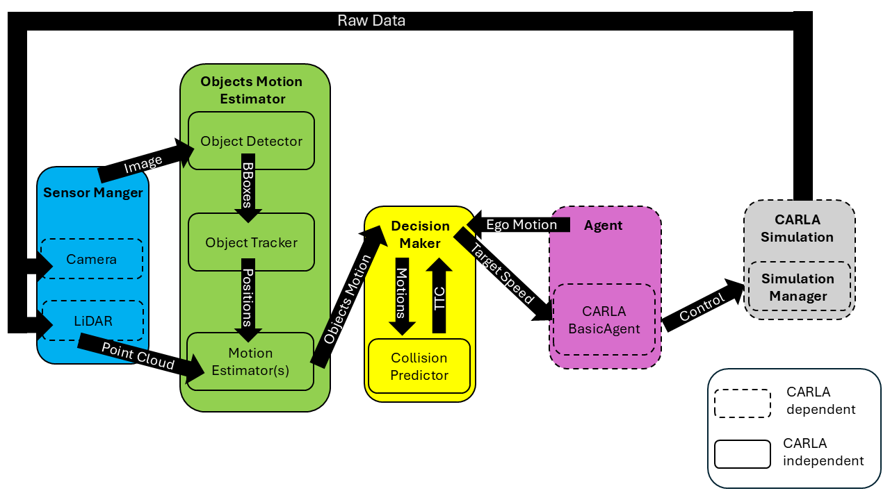
System Architecture and Key Components

Slide 7
Design Justification
Single Responsibility Principle: Each module has one clear purpose (e.g., Sensor Manager only handles sensor data).
Open–Closed Principle: Components can be extended or swapped (e.g., replacing YOLO) without changing core logic.
Liskov Substitution Principle: Modules are built against interfaces, allowing easy replacement of implementations.
Interface Segregation Principle: Interfaces are small and focused—modules only depend on what they use.
Dependency Inversion Principle: System logic relies on abstractions, not concrete classes, for flexibility and testability.

Slide 8
Original Planned Simulation Scenarios
Straight Crosswalk Scenario – A pedestrian crosses directly in front of the ego vehicle at a marked crosswalk.
Sudden Pedestrian Entry from Sidewalk – A pedestrian abruptly steps into the road from the sidewalk.
Multiple Sequential Pedestrians – Several pedestrians cross one after another, requiring sustained tracking and response.
Static Pedestrian on Road – A pedestrian remains stationary in the vehicle's path.
Pedestrian Walking on Sidewalk (No Crossing) – Ensures the vehicle doesn't stop when pedestrians are not entering the road.
Pedestrian Standing at Edge of Crosswalk – Tests system’s decision-making when a pedestrian is near the crosswalk but not crossing.

Slide 9
Final Testing Approach
Controlled scenarios were time-intensive to design and not representative of real environments
Instead: Spawned many pedestrians with random destinations with the ego vehicle given its own destination
Implicitly covered: crosswalks, sequential pedestrians, sidewalk pedestrians, edge-of-crosswalk pedestrians
Result: Much more realistic and closer to production than staged scenarios

Slide 10
Performance Metrics
Collision Count – The total number of collisions between the ego vehicle and pedestrians across all scenarios.
Unsafe Interactions – Counts any interaction where the vehicle comes within a dangerous distance of a pedestrian.
Minimum Time-To-Collision (TTC) – Tracks the smallest TTC value estimated by the system during the simulation.
Average TTC on Predicted Collisions: Reports the average TTC at the moment a collision is predicted by the system.
System Latency – Measures the time from receiving sensor data to issuing a control decision.

Slide 11
Challenges and Risks
Challenge: Sudden pedestrian entry at close range
Mitigation: Trigger an emergency stop if the Time-To-Collision (TTC) falls below a critical threshold.
Challenge: Unrealistic high velocities from reappearing objects
Mitigation: Reset motion state if an object has not been seen for a set time duration.
Challenge: Sensor desynchronization between camera and LiDAR
Mitigation: Start each sensor at the same time and only tick when every sensor received its data.

Slide 12
Evaluation Criteria
Collision Count: Must be zero; any collision is a critical failure.
Unsafe Interactions: Must be zero; any unsafe distance ≤ threshold means failure to maintain safe clearance.
Minimum TTC: Should show timely responses; higher is better, but exact values are interpreted in context and not strictly enforced.
Average TTC on Predicted Collisions: Higher is better, but evaluated relatively, not against a fixed cutoff.
System Latency: Measured and reported; only excessive delays that harm decision‑making are problematic.

Slide 13
Timeline
Weeks 1–2: System design, Sensor Manager setup, validate camera & LiDAR in CARLA
Weeks 3–4: Integrate pedestrian detection (YOLO) and tracking (DeepSORT)
Weeks 5–6: Add motion estimation (Kalman filter); unify detection, tracking & velocity estimation
Weeks 7–8: Build collision predictor and reactive vehicle control agent
Weeks 9–10: Run test scenarios and evaluate system performance
Weeks 11–12: Finalize system and ensure the evaluation criteria is met
Week 13: Final presentation and submission

Slide 14
Questions?

